Slide 1

Jordan Wang, Scilla Benussi, Winston Lin, Eleanora Undrus

Slide 2
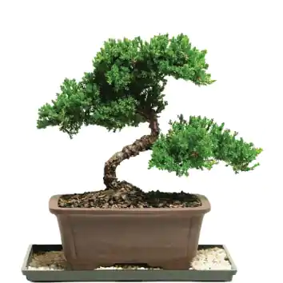
Problem
Low on time?
Forgetful?
Don’t have a green thumb?
Out of season produce?

Slide 3








OUR IDEA
freeicons.io

Slide 4



Target audience
Gardening
Small agriculture
Agricultural industry
freeicons.io

Slide 5
What makes us special?
All in one!
Water, temperature, humidity, and photosensitive system
GUI available for user
Possible real-time updates

Slide 6
Next Step
Mobile app with refilling alerts
Optimized greenhouse design
Graph functionalities
Quality improvements
Database for different plants’ ideal conditions

